Slide 1
Brief Pandora Project / Network Update
N. Abuhassan, A. Cede, A. Dimov, M. Gebetsberger, J. Herman, A. Kotsakis, A. Kreuter, M. Mueller, C. Posch, J. Robinson, D. Santana, F. Santos, L. Shalaby, E. (Spinei )Lind, A. Suliman, R.J. Swap, J. Szykman, M. Tiefengraber, M. Tzortziou, L. Valin, D. Williams, B. Wimmer
TEMPO Science Team Meeting
UW-Madison, 05 June 2019, 15:30-15:45

Slide 2
Evolution of the Project and Network
Key Highlights:
Expansion of networks
Establishment of world class calibration facilities at GSFC
Hardening of the instrument
Standardization of Network Operations
Centralization of Data Processing, QA/QC process
Detection and Mitigation of HCHO issue
Finalization of the PGN application process
First PGN STM September 17-20, 2019, hosted in Innsbruck, AT

Slide 3
Growth in Long Term Fixed Pandoras
Date | Tot. Pandoras | NASA Net Ops | ESA Net Ops | NASA Owned
08/2016 | 16 | 2 | 14 | 6
01/2017 | 28 | - | 16 | 12
08/2017 | 45 | 24 | 21 | 18
01/2018 | 51 | 29 | 22 | 21
06/2018 | 71 | 41 | 30 | 26
10/2018 | 87 | 51 | 36 | 31
5/2019 | 94* | 56 | 38 | 49
*Another ~15 on order

Slide 4
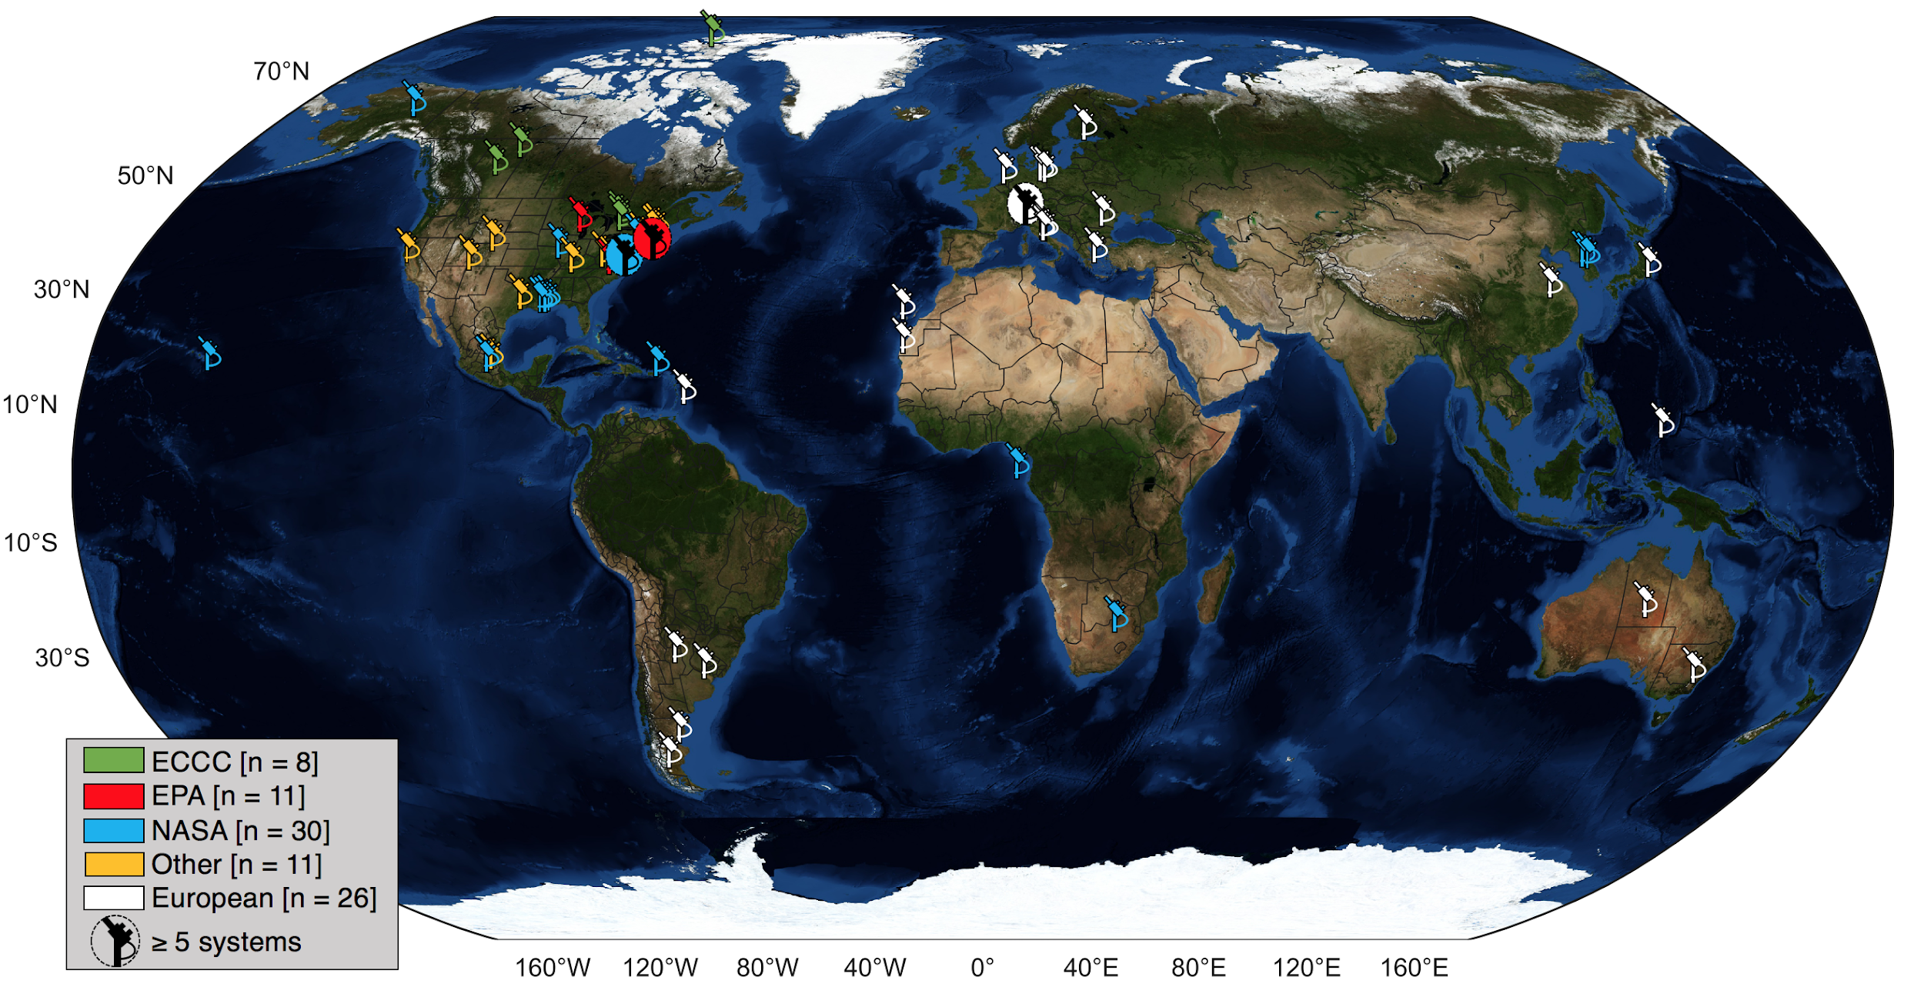
Global Pandora Distribution

Slide 5
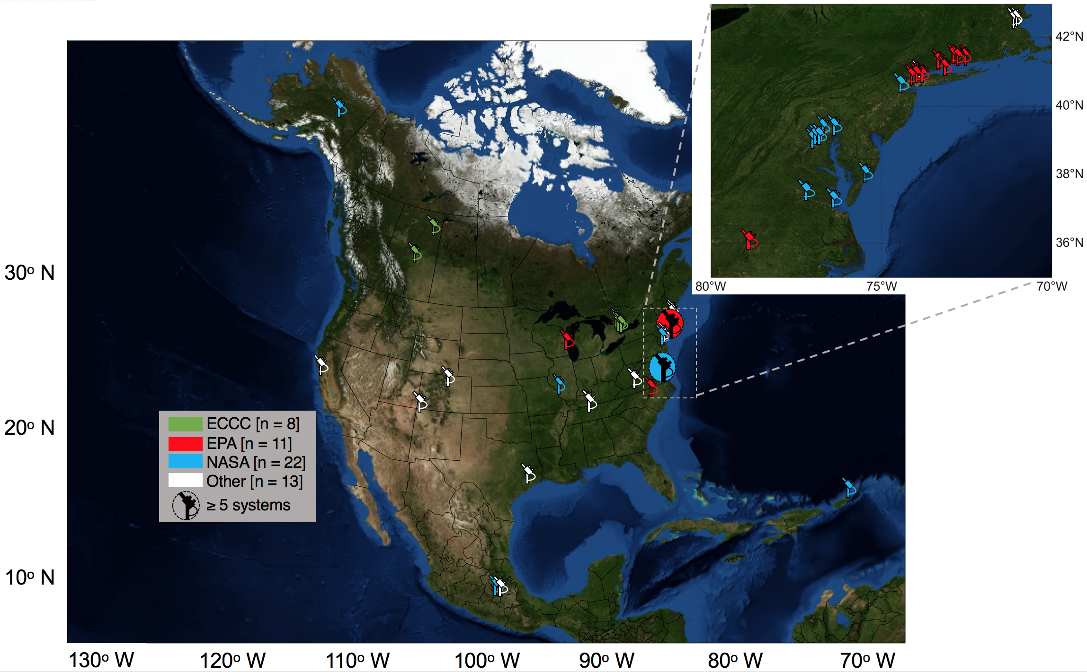
Supporting TEMPO Validation
Expanded from Szykman et al. AWMA EM submission that has been accepted for publication

Slide 6
Priorities over next 6 months
Priority 1: Supporting our National (e.g. EPA/NOAA, State agencies) and International Partners/Colleagues (e.g. ESA, NIER, ECCC, UNAM)
Priority 2: Supporting Satellite (TEMPO, S5P, GEMS) validation/ verification activities
Priority 3: Resolving HCHO – requires working with EPA/others w HCHO capabilities, deployment of 3-4 Delrin free instruments alongside existing ones (~1 month)
Priority 4: TOLNET deployments – (e.g. UAH, TMF, ARC - ~2 months)

Slide 7
Priorities over next 6 months
Priority 5: Returns of reconfigured instruments – (e.g. WFF, LaRC, VCU, UMBC, HU-Beltsville)
Priority 6: Support of Field Campaigns (FIREX, WI DNR - ~ 1 month)
Priority 7: Continuation of bringing home, upgrading* existing and redeploying NASA fleet of instruments (e.g. SLU, UAF, Rutgers, etc. - ongoing)
Priority 8: new builds - ongoing
*Upgrades include tracker, PCB, fiber guide, nylon, etc.)

Slide 8
Thank you...
Acknowledgments: Colleagues/PIs hosting or owning Pandoras, as well as Colleagues at GSFC (610/613/614), at LaRC, with TOLNET, AERONET
For much more detailed information please refer to our slide rack from yesterday afternoon’s session!

